Slide 1
General Meeting #
MOVING FURTHER INTO FINANCE
October 13th, 2021

Slide 2
Before Breakout Meetings
SECTION I
QUICK REMINDERS

Slide 3
Reminders for this Coming Week
Reminders
Turn On Slack Notifications! Please
Signup on the USIT portal and pay dues
Dates
QMI General Meeting #8 (10/20/21)
USIT General Meeting #6 (10/19/21)
Homework #2 Due Before Meeting #8 (10/20/21)
FY Meeting #1 (10/24/21)

Slide 4
Introduction to Regression
ALEX

Slide 5
Our Direction
HOW WE CAN THINKING ABOUT MODELING
Regression
Classification
Supervised
Unsupervised
Linear Regression
Logistic Regression
SVM

Slide 6
Regression Introduction
REGRESSIONS ARE A METHOD OF FINDING CORRELATION
We use regression to predict a dependent variable from one, or many, independent variables
Denote the true value as y and the predicted response as y-hat
Thus we can make a prediction of y-hat based on a linear combination of x variables
As a general rule a well fit regression does not imply a level of causation
There are four requirements for a relationship to be causation (and an addition six for time series)
A successful regression does imply correlation (which is bidirectional)
We will go over some intro linear regressions, the math behind them, and best use cases
Regression cases can often be reframed as classification questions
e.g. Predicting height from weight

Slide 7
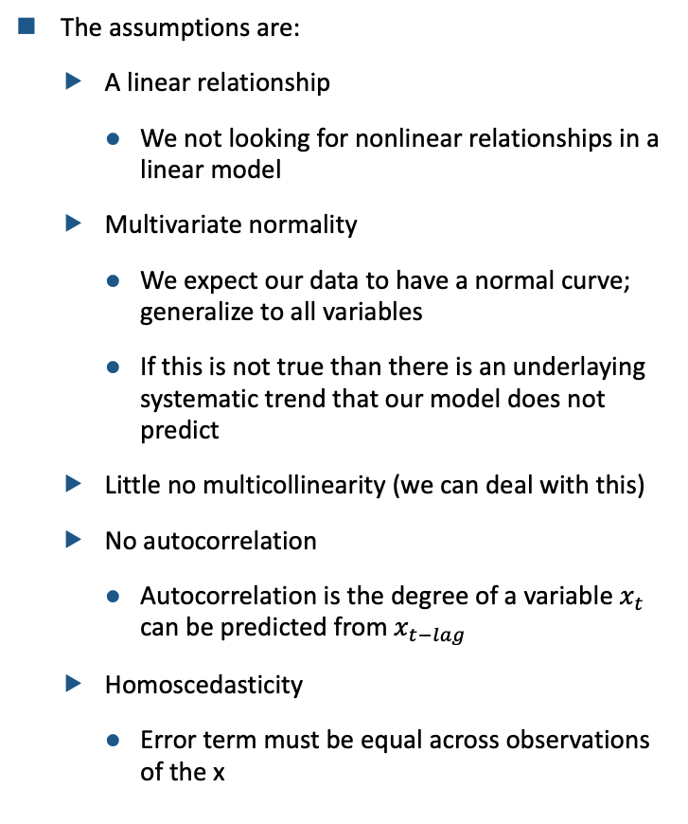
Assumptions of Linear Models
LINEAR MODES HAVE FOUR ASSUMPTIONS ABOUT THEIR DATA
The assumptions are:
A linear relationship
We not looking for nonlinear relationships in a linear model
Multivariate normality
We expect our data to have a normal curve; generalize to all variables
If this is not true than there is an underlaying systematic trend that our model does not predict
Little no multicollinearity (we can deal with this)
No autocorrelation
Autocorrelation is the degree of a variable $x_{t}$ can be predicted from $x_{t−lag}$
Homoscedasticity
Error term must be equal across observations of the x

Slide 8
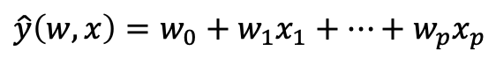
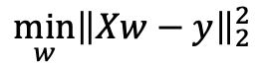
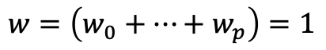
Ordinary Least Squares
PROBABLY THE MODEL YOU HAVE BEEN INTERESTED
The OLS uses a minimize optimization function to reduce the absolutely value of the residuals
Define residuals as the absolute value of the different between y minus y-hat
We find the square of residuals because we do not want them to “cancel out”
Issues with OLS regression:
High degree of sensitivity to outliers
Assumes a normal distribution of noncorrelated error terms
Assumes input data normality
Little justification in most cases for squared error being the correct measure of model success
Outliers is an important question for OLS, there are a few ways to deal with outliers:
Removal
Normalizing the data (point movement)
Using a different mode (e.g. Ridge)
$$\min_{w}{{\left\|Xw−y\right\|}_{2}^{2}}$$
$$\hat{y}\left(w, x\right)=w_{0}+w_{1}x_{1}+…+w_{p}x_{p}$$
$$w=\left(w_{0}+…+w_{p}\right)=1$$

Slide 9
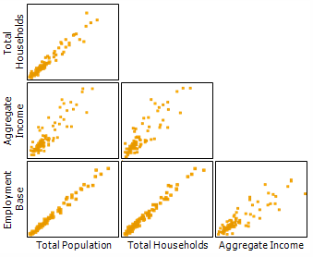
Multicollinearity (Part One)
COMMON PROBLEM IN STATISTICS AND DATA COLLECTION
Multicollinearity is when 2+ of the independent variables are correlated with each other
This arises in two main ways:
Structural: If you are creating a variable from another than they will more than likely be colinear
Data-Collection: If you are collecting data from the wild often there will be confounders that relate possible variables to each other
Effects of multicollinearity:
It inflates your error terms because no every error “happens twice”
Leads to unfair responses in y-hat based on small changes in an independent variables
We can find it using variance influence factor (VIF) which measure the relationship of correlation between variables

Slide 10
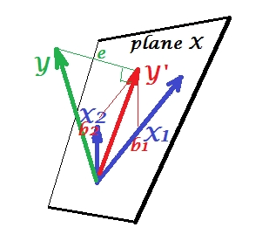
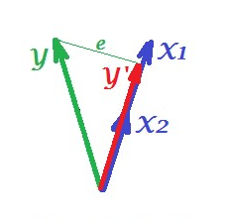
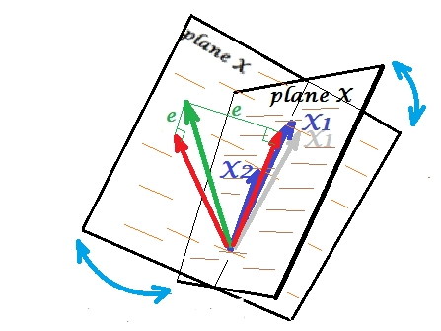
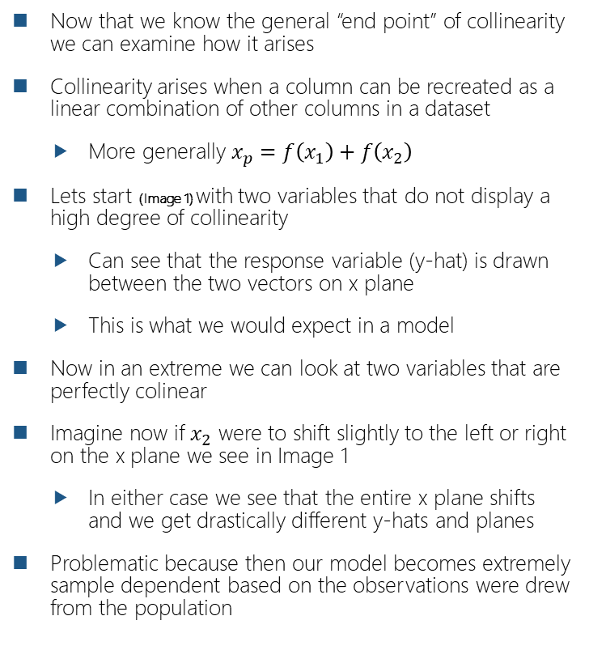
Multicollinearity (Part Two)
VISUALLY INTERPRATING COLLINEARITY
Now that we know the general “end point” of collinearity we can examine how it arises
Collinearity arises when a column can be recreated as a linear combination of other columns in a dataset
More generally $x_{p}=f\left(x_{1}\right)+f\left(x_{2}\right)$
Lets start (Image 1) with two variables that do not display a high degree of collinearity
Can see that the response variable (y-hat) is drawn between the two vectors on x plane
This is what we would expect in a model
Now in an extreme we can look at two variables that are perfectly colinear
Imagine now if $x_{2}$ were to shift slightly to the left or right on the x plane we see in Image 1
In either case we see that the entire x plane shifts and we get drastically different y-hats and planes
Problematic because then our model becomes extremely sample dependent based on the observations were drew from the population
Image 1
Image 2
Image 3

Slide 11
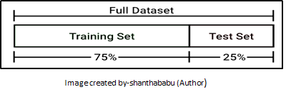
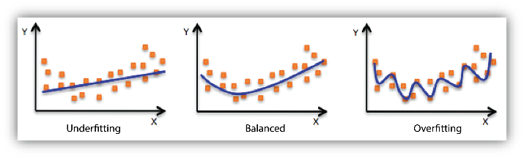
Model Fit - Training and Testing
MODELING BASICS OF “LEARNING” FROM DATA
Given a dataset (a sample) of a population we will split it into a training and test set
This helps “actually” test the model
Several different ways to do this, we will start with just a simple split (assuming randomized data sequencing)
Lets say that now we have split our data and trained our model on the training set
Remember that you are going to optimize your model on the train set not the test
About to move to test set to see actual model success
There are two possible “bad” scenarios to be in after fitting:
Overfitting: this is when the model pays too much attention to the training set
Underfitting: this is when the model pays to little attention to the training set
In both cases we have a model that will perform poorly on a testing set
The different sources of error come from bias and variance (two different types of error “creators”)

Slide 12
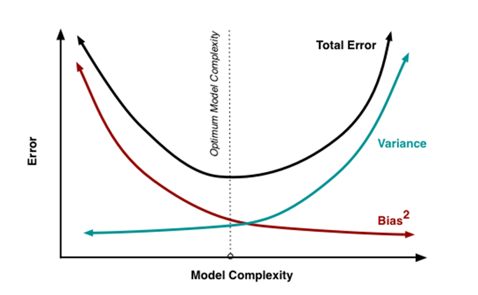
Bias and Variance Creating Error
KEY INPUTS INTO TOTAL ERROR OF A MODEL
We have error that can manifest from a model learning too much or too little from the training set
This error comes from two different sources:
Bias: the difference between model prediction (y-hat) and the actual value (y)
Variance: the spread of our predictions for individual y-hat (with each other)
Bias and variance combine with irreducible error, error that comes from information we do not have data on, to create total model error
There is a trade-off between bias and variance inside of every model
If variance decreases bias must increase because this means the model is learning more about the training set preventing generalizations
If variance decreases bias must decrease because it is learning more about the generalizable trends of the data outside of the training set
This relates to model complexity, we would expected models that have higher variance to be more complex because they are more aggressively tracking individual observations
$$Error={Bias}^{2}+Variance+Irr. Error$$
$$Error= {\left(E\left[\hat{f}\left(x\right)−f\left(x\right)\right]\right)}^{2}+E\left[{\left(\hat{f}\left(x\right)−E\left[\hat{f}\left(x\right)\right]\right)}^{2}\right]+σ_{e}^{2}$$

Slide 13
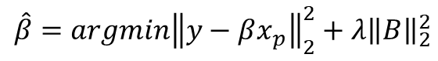
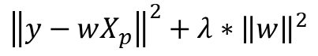
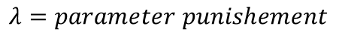
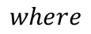
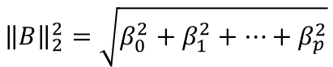
Ridge Regression (Part One)
BUILDS ON OLS TO *ATTEMPT* TO SOLVE THE BIAS-VARIANCE TRADE-OFF
OLS is recognized as the best linear unbiased estimator (BLUE) because it minimizes the residuals of the model
Ridge adds a L2 regularization or “punishment” to the betas of variables
This has the effect of breaking down the relationship between colinear variables because it increase asymptotically
OLS focuses on fitting the existing training set, but has no method generalizing these finding to the testing set
L2 regularization punished the betas of variables based on their magnitude
Referencing the perfectly correlated vectors we can see that they have different magnitude meaning they will be punished in a different manner
This allows the model to generalize better to the test set because L2 forces betas to be “off” from their original OLS prediction
This is controlled by a lambda terms
$${\left\|y−wX_{p}\right\|}^{2}+λ∗{\left\|w\right\|}^{2}$$
$$\hat{β}={argmin\left\|y−βx_{p}\right\|}_{2}^{2}+{λ\left\|B\right\|}_{2}^{2}$$
$$where$$
$${\left\|B\right\|}_{2}^{2}=\sqrt{β_{0}^{2}+β_{1}^{2}+…+β_{p}^{2}}$$
$$λ=parameter punishement$$

Slide 14
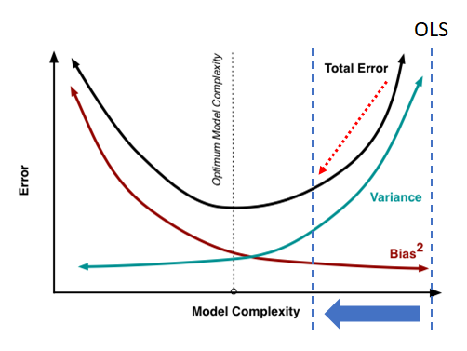
Ridge Regression (Part Two)
FINAL NOTES ON RIDGE REGRESSION
From the equation in the previous slide we can see that there is still the development of an OLS
Lambda is a hyperparameter in the Ridge regression which is set by you and determines the influence of the L2 regularization
A lambda of zero means that: Ridge = OLS
Higher lambda complete destroy collinearity of the data and cause underfitting
As mentioned earlier OLS is BLUE which means it is unbiased
We can see this graphically to the right where OLS is on the far right
Ridge attempts to move the OLS lines further to the left to minimize total error (which we know is more than just variance)

Slide 15
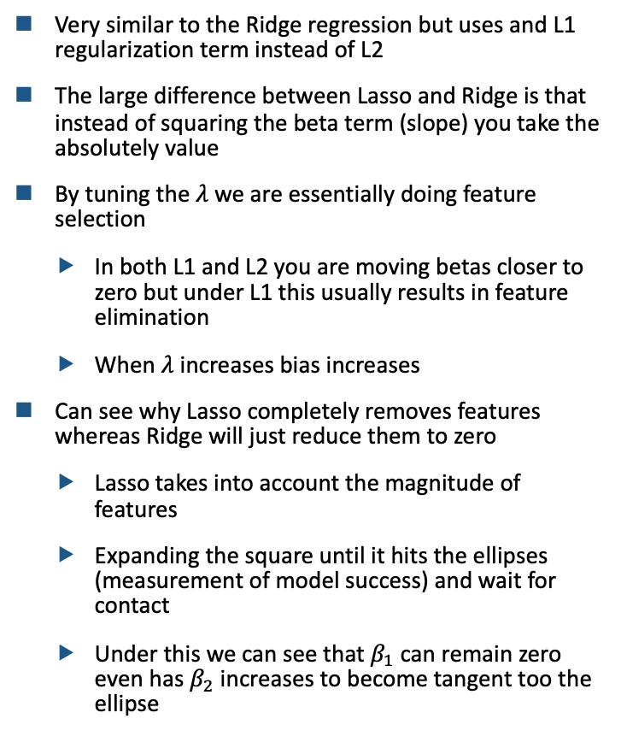
Lasso Regression
USES AN L1 REGULATION INSTEAD OF L2 (FROM RIDGE)
Very similar to the Ridge regression but uses and L1 regularization term instead of L2
The large difference between Lasso and Ridge is that instead of squaring the beta term (slope) you take the absolutely value
By tuning the $λ$ we are essentially doing feature selection
In both L1 and L2 you are moving betas closer to zero but under L1 this usually results in feature elimination
When $λ$ increases bias increases
Can see why Lasso completely removes features whereas Ridge will just reduce them to zero
Lasso takes into account the magnitude of features
Expanding the square until it hits the ellipses (measurement of model success) and wait for contact
Under this we can see that $β_{1}$ can remain zero even has $β_{2}$ increases to become tangent too the ellipse

Slide 16
Cross-Validation
STARTED WITH TRAIN-TEST SPLIT
We began this lecture with the assumption that there was a train and test split (usually around 0.75/0.25)
Some potential problems with this:
You data is not randomized within the dataframe (granted this is an easy fix)
You get a unique test set that is not representative of the sample or the population
Becomes a larger issue with n is not large
You cannot “presplit” your data
We can solve this we cross-validation, which essentially folds the data over and over again
The standard is typically seven-fold CV
CV folds the data differently every time and ensures that results are generalizable
General steps are:
Shuffle
Split into subsets
Within each subset create a train and test group and run the regression and record statistics

Slide 17
Uniqueness versus Stability
HOW THEY ARE DIFFERENT AND SIMILIAR
We can define these terms as:
Uniqueness: Given a fixed dataset we always get the same result back
Stability: The output does not vary significantly if the dataset is altered slightly
We would define Ridge (L2) as stable because it does not eliminate terms
We would define Lasso (L1) as unstable because it reduces coefficients to zero
Has been shown that cross-validation leads to unstable models because it changes the data
Issue with Lasso because given various beta inputs small changes could lead to large changes in your response variables (angles)
If Lasso is unstable, but nonetheless a good model what can we do… multi-task lasso
THERE REALLY IS JUST A NOT A GOOD PHOTO FOR THIS

Slide 18
Multi-Task Lasso
MODIFICATION OF ORIGINAL LASSO
Disclaimer: MTLasso might be unstable, but this might not truly matter
We care about stability because we want the same result consistently when generalized
Selection + CV = Selection + good lambda
Thus, in some cases it might not matter that there is instability because risk is consistent
MTLasso sets the features that should be included in every iteration of a model initially
This means that the features being scaled are the same from k-fold to k-fold
Obviously, this increases model stability
Works only if you have a general idea of what features you want to include in your model

Slide 19
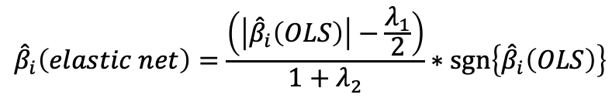
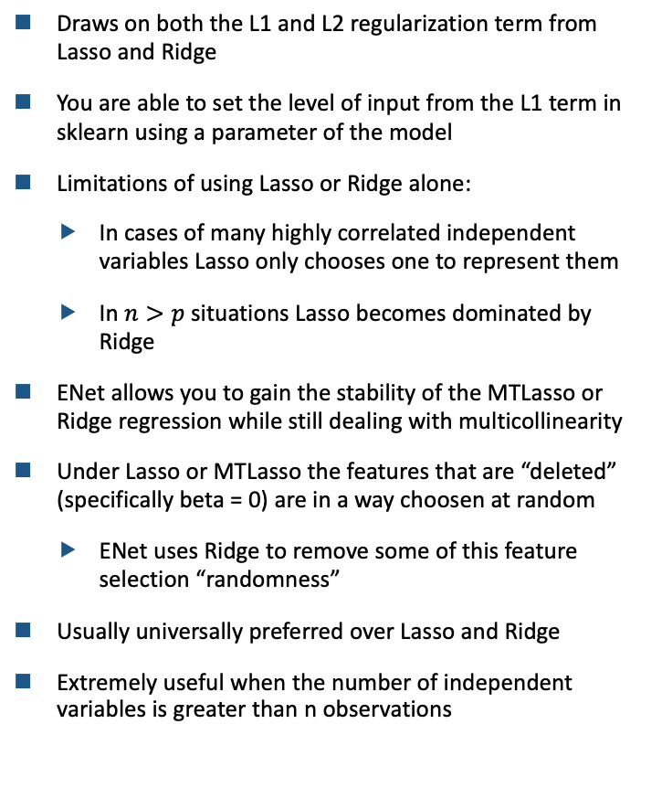
ElasticNet (Part One)
INTRODUCTION TO ELASTIC NET
Draws on both the L1 and L2 regularization term from Lasso and Ridge
You are able to set the level of input from the L1 term in sklearn using a parameter of the model
Limitations of using Lasso or Ridge alone:
In cases of many highly correlated independent variables Lasso only chooses one to represent them
In $n>p$ situations Lasso becomes dominated by Ridge
ENet allows you to gain the stability of the MTLasso or Ridge regression while still dealing with multicollinearity
Under Lasso or MTLasso the features that are “deleted” (specifically beta = 0) are in a way choosen at random
ENet uses Ridge to remove some of this feature selection “randomness”
Usually universally preferred over Lasso and Ridge
Extremely useful when the number of independent variables is greater than n observations
$${\hat{β}}_{i}\left(elastic net\right)=\frac{\left(\left|{\hat{β}}_{i}\left(OLS\right)\right|−\frac{λ_{1}}{2}\right)}{1+λ_{2}}∗sgn\left\{{\hat{β}}_{i}\left(OLS\right)\right\}$$

Slide 20
ElasticNet (Part Two)
BETTER MORE GENERALIZABLE MODELS
ENet generalizes to all other forms of regularization because it is pessimistic
In both L1 and L2 regularization the result is independent variables being pulled to zero
Because of this at a certain point there are few questions that different combinations of L1 and L2 cannot solve
Allows us to moderate Ridge regression
Remember that Ridge punishes large betas more, but in some cases this might be better
e.g. predicting and individuals income and one of the factors is parents income

Slide 21
Least Angle Regression
A GREEDY MODEL
LARS is a forward stepwise function that iteratively builds a model
First a stepwise function is one that adds (or subtracts) features iteratively
LARS starts with a model the size of 0 and then will add features as it “steps” forward
Method of adding features:
LARS will add a variable if it is the one that is most correlated with the dependent variable
It does this over-and-over again iteratively building a model
e.g. if you have x1 and x2 with given betas the next variable added will be the one with the best correlation to the y
Most often used to supplement Lasso because it is faster and does not necessarily remove some features

Slide 22
Important Takeaways
LOOKING BACK AT MODELS COVERED
Something that I did not realize until later was that models and our ability to model changes over time
We can see this in the regressions we have covered today
OLS > Ridge/LASSO > Enet > LARS
Overtime models are created to answer the issues that different models created
Implies that no model is perfect
We have a way to answer this with voting regressions and ensemble regressions

Slide 23
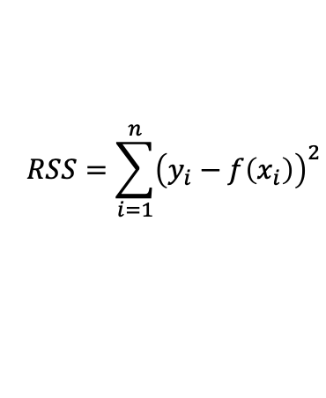
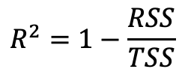
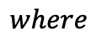
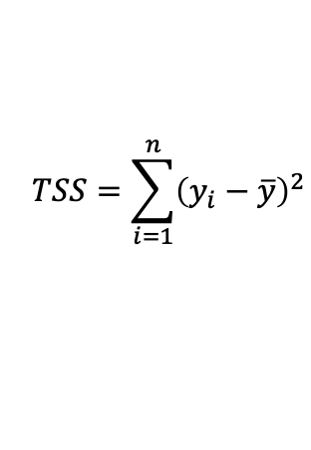
R-Squared is Not Great
SO FAR WE HAVE NOT SPECIFIED THE METRIC FOR WHICH OUR MODEL WILL LEARN FROM
We know that models need to ”know” a way they are doing well
See this in OLS with the use of R-squared and minimizing variance (residuals)
There are other ways we can measure model success
Problems with R-squared:
Required that residuals sum to one because we assume that they are normally distributed
Increasing the number of variables increases R-squared regardless of their ”actual” value
Can get “good” R-squared even if the relationship is non-linear
Does not allow you to generalize to prediction error, all you know is about the size of residuals
Cannot compare across model of transformed and nontransformed Y
You get the same R-squared if you regress X on y or y on X
$$R^{2}=1−\frac{RSS}{TSS}$$
$$where$$
$$RSS=\sum_{i=1}^{n}{{\left(y_{i}−f\left(x_{i}\right)\right)}^{2}}$$
$$TSS=\sum_{i=1}^{n}{{\left(y_{i}−\overline{y}\right)}^{2}}$$

Slide 24
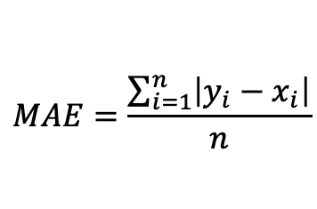
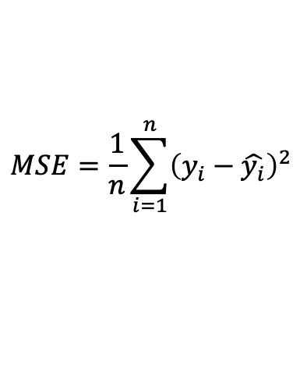
Different Metrics for Model Success
LOOK AT TWO MORE METRICS THAT CAN BE USED WITH REGRESSION
Mean Squared Error (MSE)
Find the squared error value between predictions and outcomes
MSE gives more weight to large errors which we would say is most likely good (do not care about small difference in actuality)
Mean Absolute Error (MAE)
Gives the absolute value of errors
MAE is more robust to outliers in prediction because of the lack of squaring
$$MSE=\frac{1}{n}\sum_{i=1}^{n}{{\left(y_{i}−\hat{y_{i}}\right)}^{2}}$$
$$MAE=\frac{\sum_{i=1}^{n}{\left|y_{i}−x_{i}\right|}}{n}$$

